Slide 1
Blinkit Data Analysis using Power BI
Insights into Total Sales, Total Items & Average rating

Slide 2
Dataset Overview
Dataset Name: Blinkit Sales
Source: Kaggle
Tools & Technologies
Power BI
Excel
Data cleaning & transformation

Slide 3
blinkit Analysis
BUSINESS REQUIREMENT
To conduct a comprehensive analysis of Blinkit's sales performance, customer satisfaction, and inventory distribution to identify key insights and opportunities for optimization using various KPIs and visualizations in Power BI.
KPI’s Requirements
Total Sales: The overall revenue generated from all items sold.
Average Sales: The average revenue per sale.
Number of Items: The total count of different items sold.
Average Rating: The average customer rating for items sold.

Slide 4
blinkit Analysis
BUSINESS REQUIREMENT
Granular Requirements
1. Total Sales by Fat Content:
Objective: Analyze the impact of fat content on total sales.
Additional KPI Metrics: Assess how other KPIs (Average Sales, Number of Items, Average Rating) vary with fat content.
2. Total Sales by Item Type:
Objective: Identify the performance of different item types in terms of total sales.
Additional KPI Metrics: Assess how other KPIs (Average Sales, Number of Items, Average Rating) vary with fat content.
3. Fat Content by Outlet for Total Sales:
Objective: Compare total sales across different outlets segmented by fat content.
Additional KPI Metrics: Assess how other KPIs (Average Sales, Number of Items, Average Rating) vary with fat content.
4. Total Sales by Outlet Establishment:
Objective: Evaluate how the age or type of outlet establishment influences total sales.

Slide 5
blinkit Analysis
BUSINESS REQUIREMENT
Chart’s Requirements
5. Percentage of Sales by Outlet Size:
Objective: Analyze the correlation between outlet size and total sales.
6. Sales by Outlet Location:
Objective: Assess the geographic distribution of sales across different locations.
7. All Metrics by Outlet Type:
Objective: Provide a comprehensive view of all key metrics (Total Sales, Average Sales, Number of Items, Average Rating) broken down by different outlet types.

Slide 6
Dashboard Overview

Slide 7
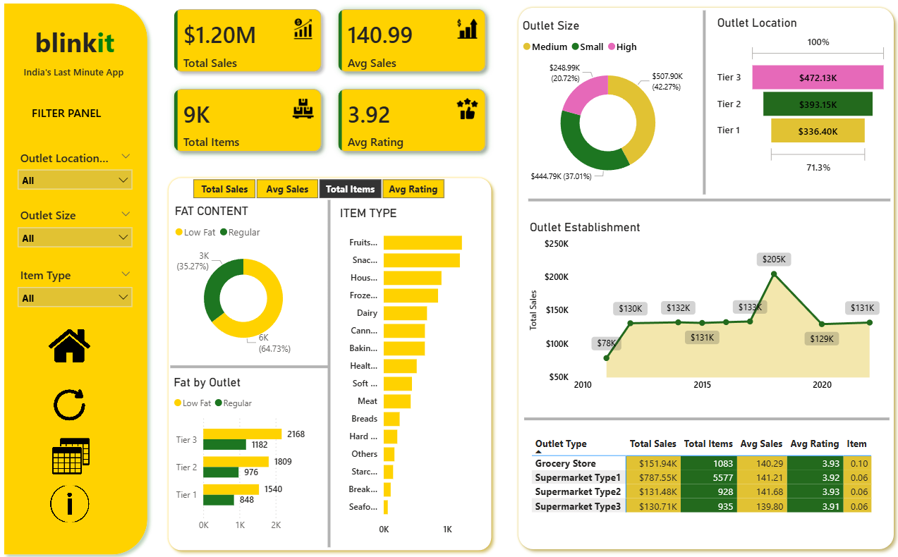

Slide 8
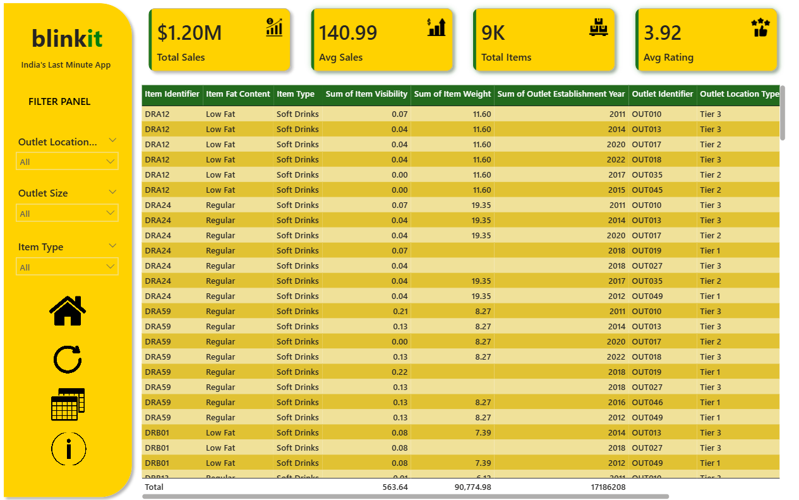

Slide 9
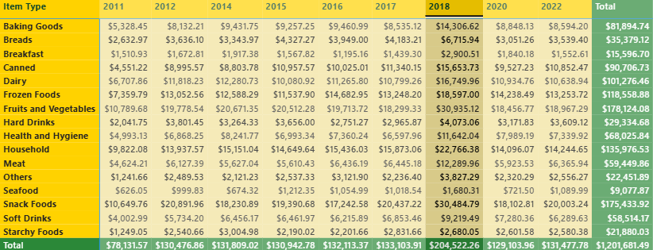
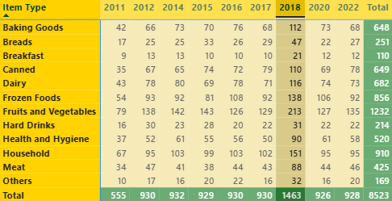
Key Insights
1. Total Sales by Year Sales peaked in 2018, reaching approximately $205K, which represents a 40% increase compared to the previous year. This significant growth can be attributed to the expansion in the number of outlets, which rose to 1,463 in 2018—an increase of 36% year-over-year.
2. Outlet Type Analysis Supermarket Type1 dominates the business with 5,577 outlets, generating the highest total revenue of approximately $787K. In comparison, there are 1,083 grocery stores contributing around $152K in revenue. Supermarket Type2 and Supermarket Type3 have a similar number of outlets—928 and 935 respectively—each generating nearly comparable revenue of about $131K and $130K. Overall, Supermarket Type1 plays a key role in driving the majority of sales.

Slide 10
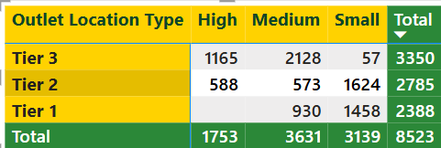
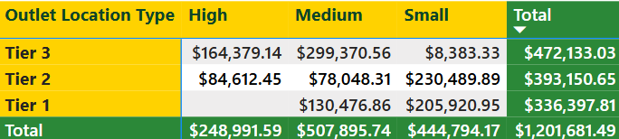
Key Insights
3. Item Type: Fruits & Vegetables, Snack Foods, and Household categories are the top three best-performing item types. Fruits & Vegetables generated approximately $178K in revenue with 1,232 units sold, followed closely by Snack Foods with $175K from 1,200 units. Household items contributed $135K in revenue with 910 units sold.
Together, these three categories account for nearly 40% of total revenue and 39% of total units sold, highlighting their significant contribution to overall sales performance.
4. Outlet Location:
Tier 1: $336.40K (28%)
Tier 2: $393.15K (32%)
Tier 3: $472.13K (39%)
5. Outlet Size

Slide 11
Key Insights
6. Item Fat Content:
Low Fat items dominate sales performance, contributing approximately 64% of total revenue, while Regular Fat items account for the remaining 36%. This indicates a strong customer preference for low-fat products, making them a key driver of overall revenue.

Slide 12
Thank You

